Slide 1
TIME SERIES FORECASTING AND OPTIMIZATION
Meera Palanivel
Niyati Mudliar
Abhishu Tailor
Praveena Venu
Nithin Thomas
Sasi Kumar
Aravind Chintalapudi
Praveen Kumar Singh Jadon

Slide 2

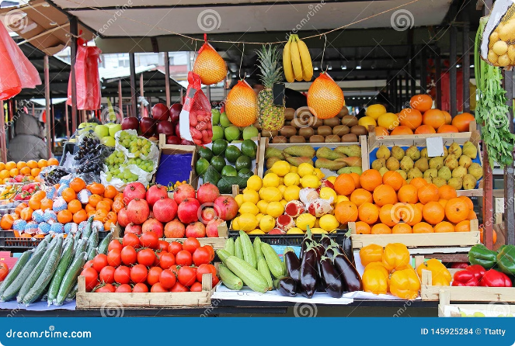
Demand Forecasting for Perishable Short Shelf-Life Homemade Food at iD Fresh Food
The food industry is constantly evolving, with changing consumer preferences and demands. This case study delves into the intricacies of demand forecasting for perishable short shelf-life homemade food products at iD Fresh Food. iD Fresh Food, a leading player in the ready-to-cook food segment, faces the challenge of predicting daily demand for its products to optimize production and distribution. This presentation will explore the company’s background, manufacturing and distribution processes, and the analytical model developed to address this complex issue. We will highlight the key factors influencing demand forecasting and examine how iD Fresh Food leverages data and technology to create a more efficient and responsive organization.

Slide 3

Introduction & Problem Statement
1
iD Fresh Food: A Pioneer
2
Product Portfolio
iD Fresh Food, established in 2005, has established itself as a leader in the ready-to-cook, preservative-free food market. The company's commitment to providing authentic, homemade flavors has earned them a loyal customer base.
iD Fresh Food offers a diverse range of products including idli-dosa batter, parotas, chapatis, curd, and paneer, catering to the diverse culinary needs of its customers.
3
The Challenge: Perishable Goods
4
Demand Forecasting for Success
The short shelf-life of their products, due to the lack of preservatives, presents a unique challenge. Predicting demand accurately is crucial to minimize returns and prevent stock-outs, optimizing operational efficiency.
The primary goal is to develop a robust demand forecasting model that can effectively predict daily demand for each product at the store level. This model will play a pivotal role in aligning production with actual demand, minimizing waste, and enhancing customer satisfaction.

Slide 4

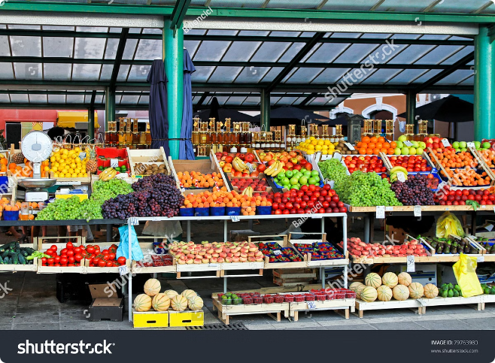
Company Background
1
Humble Beginnings
Founded by PC Mustafa and his cousins, iD Fresh Food started with a small operation, producing just 10 packets of idli-dosa batter per day in 2005.
2
Rapid Growth
Through consistent quality, dedication, and innovation, the company saw remarkable growth, reaching a production capacity of 50,000 packets per day by 2017.
3
Expanding Reach
iD Fresh Food expanded its operations to key markets across India, including Bengaluru, Chennai, Pune, Mumbai, Delhi, Hyderabad, and Dubai, establishing a strong presence in major urban centers.

Slide 5
Sales and Distribution Model
Daily Beat Model
Replenishment Based on Sales
Minimizing Waste
iD Fresh Food employs a daily beat model for distribution, ensuring fresh products reach stores every day. Over 200 vehicles are dedicated to delivering products across their operational areas.
The daily beat model aims to reduce stock-outs and returns, minimizing product waste and ensuring that customers always have access to fresh products. This focus on efficiency is crucial for a company dealing with perishable goods.
Each day, salesmen visit stores, assess the previous day's sales data, and replenish stock accordingly. This ensures that stores have adequate supplies without excessive inventory.

Slide 6


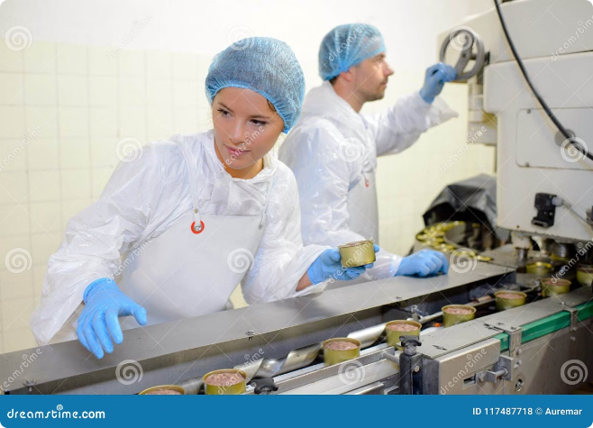


Manufacturing Process
High-Quality Ingredients
iD Fresh Food is committed to using only high-quality, fresh ingredients in its products. The company sources its ingredients from trusted suppliers, ensuring the best quality for its customers.
Daily Production
To maintain freshness, production occurs daily, with a focus on preserving the natural flavors and textures of the ingredients. This ensures that consumers receive the freshest possible products.
Cold Fermentation
iD Fresh Food employs a 12-16 hour cold fermentation process for its batter products. This process enhances flavor and texture while ensuring the safety and quality of the products.

Slide 7

Distribution Model: Optimizing Efficiency
Key Features
Details
Fleet Size
200+ vehicles across 6 cities
Delivery Frequency
Daily replenishment
Route Optimization
Software algorithms used to plan efficient routes and minimize delivery times.
Inventory Management
Real-time tracking of stock levels at stores and warehouses.

Slide 8





Analytical Model: Forecasting Demand at the Store Level
Historical Sales Data
Returns Data Analysis
Time Series Analysis
Predictive Algorithms
The model utilizes historical sales data at the store level for each SKU. This data provides insights into past demand patterns and seasonal variations.
Time series analysis techniques are applied to the sales and returns data to identify trends, seasonality, and other patterns that influence demand.
The model employs advanced predictive algorithms to forecast future demand based on historical data and identified patterns. These algorithms are continuously refined based on new data and market insights.
Returns data is also incorporated into the model to understand factors leading to product returns. This helps identify potential issues with production or distribution.

Slide 9


Creating a More Predictable and Responsive Organization
The analytical model implemented by iD Fresh Food aims to create a more predictable and responsive organization. This approach will streamline production, optimize distribution, and ultimately increase SKU velocity, reducing operational challenges and enhancing customer satisfaction. The success of this initiative will be measured by its ability to minimize returns, avoid stock-outs, and ensure that customers consistently receive fresh, high-quality products. This will not only benefit iD Fresh Food, but also contribute to building a more sustainable and efficient food supply chain.

Slide 10
QUESTIONS AND ANSWERS

Slide 11



1. Data-Driven Optimization for iD Fresh Foods
This presentation outlines a comprehensive approach to addressing the business challenges faced by iD Fresh Foods, a leading provider of fresh, high-quality food products. We will delve into the company's specific needs, analyze existing data limitations, and propose data-driven solutions using advanced analytics. By leveraging the power of predictive modeling and optimization, iD Fresh Foods can improve its forecasting accuracy, streamline operations, and enhance customer satisfaction.

Slide 12
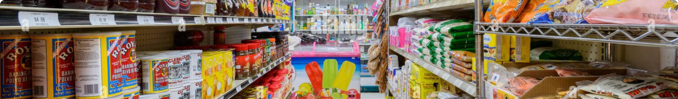
Business Problem: Demand Forecasting
Product Demand Optimization
SKU Velocity Enhancement
iD Fresh Foods needs to accurately predict daily product demand to ensure consistent service to retail stores. This involves optimizing production quantities to meet fluctuating customer needs and minimizing inventory waste.
Understanding demand patterns allows iD Fresh Foods to determine the precise quantity of each SKU required for delivery to each store on a given day. This ensures optimal stock levels and maximizes sales potential.
Product Freshness Management
Loss Minimization
Given the perishable nature of iD Fresh Foods products, preserving freshness and quality is crucial. Forecasting models help manage inventory turnover, minimizing losses due to spoilage and ensuring product availability.
Balancing inventory levels is critical for iD Fresh Foods to avoid overstocking and understocking. By accurately predicting demand, the company can minimize losses associated with excess inventory and stock-outs.

Slide 13

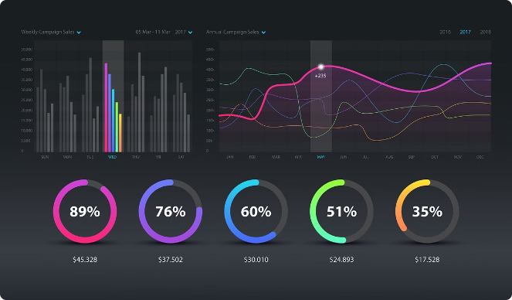
2 . Analytical Challenges
1
Incomplete Data
iD Fresh Foods lacks direct capture of stock-out information, relying on inference. This poses a challenge in accurately assessing demand patterns and forecasting future trends.
2
Return Data Gaps
The absence of detailed information about return reasons, particularly those related to damage or expiry, hampers the analysis of product quality and shelf-life performance.
3
Demand Fluctuations
The irregular and fluctuating demand patterns at retail stores require robust forecasting models that can accurately predict and adapt to these variations.
4
Seasonal Variations
Seasonal peaks and dips in demand necessitate forecasting models capable of incorporating seasonal patterns and adjusting projections accordingly.

Slide 14
Addressing Data Gaps
Data Collection Enhancement
Data Integration and Enrichment
Data Cleansing and Preprocessing
Implement robust data collection mechanisms to capture real-time stock-out information, return reasons, and customer feedback. This will provide a more comprehensive view of demand patterns and product performance.
Integrate data from various sources, including point-of-sale systems, inventory management systems, and customer feedback platforms. This will create a unified dataset for accurate analysis and forecasting.
Cleanse and pre-process data to remove inconsistencies, errors, and missing values. This step ensures data quality and reliability for accurate forecasting models.

Slide 15

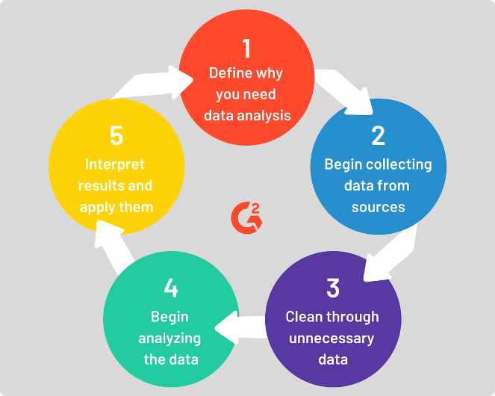
3. Forecasting Model Selection
1
Beat Level Forecasting
Begin by implementing forecasting models at the beat level, considering the limitations of store-level data accuracy. This approach aggregates demand across a group of stores within a specific geographic region.
2
Individual Store Level Forecasting
As data collection improves and models become more sophisticated, transition to individual store level forecasting. This will provide more granular insights into demand patterns and enable optimized stock management.
3
Hybrid Approach
Explore a hybrid approach that combines beat level and individual store level forecasting. This strategy leverages the strengths of both approaches to optimize demand prediction and inventory management.

Slide 16

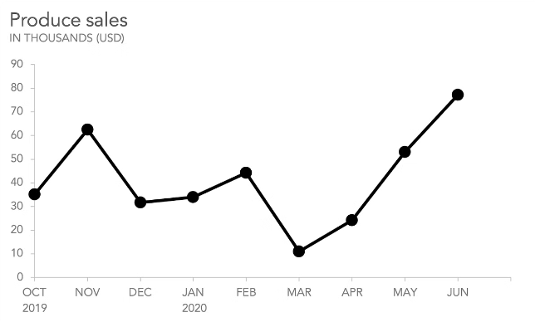
4. Beat Level Forecasting Model
Technique
MAPE
ARIMA
22.87%
Prophet
21.54%
Holt-Winters
24.32%
Exponential Smoothing
23.98%
The chosen forecasting technique should be evaluated based on its performance metrics, particularly the Mean Absolute Percentage Error (MAPE). A lower MAPE indicates higher forecasting accuracy. For instance, Prophet demonstrates the lowest MAPE of 21.54%, suggesting its suitability for forecasting demand for Beat 81 and SKU 95.

Slide 17

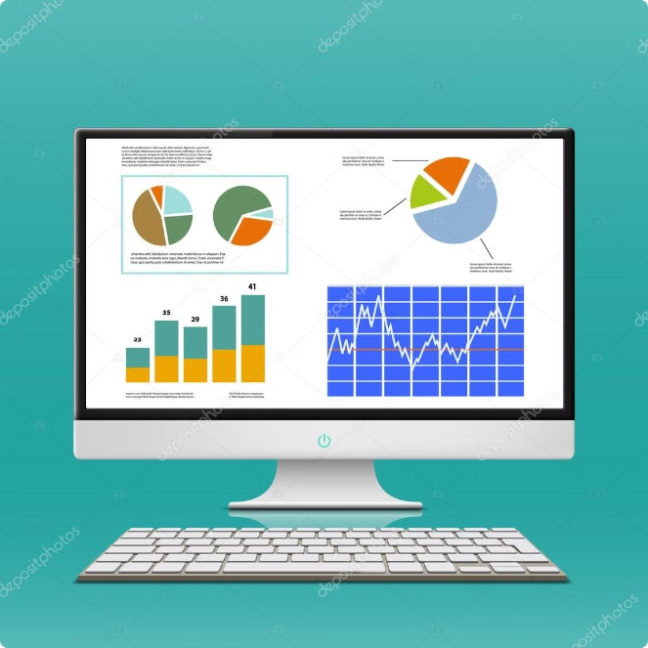




5. Model Deployment and Optimization
Pilot Testing
Conduct pilot testing of the forecasting model in a limited number of stores to validate its accuracy and effectiveness in real-world scenarios.
Integration
Integrate the forecasting model with existing IT systems and sales applications to ensure seamless data flow and operational efficiency.
Training and Education
Provide training to salesmen and relevant staff on using the forecasting insights for inventory management and demand forecasting.
Monitoring and Adjustment
Continuously monitor the model's performance, evaluate its accuracy against actual demand, and make necessary adjustments to improve its predictive capabilities.

Slide 18
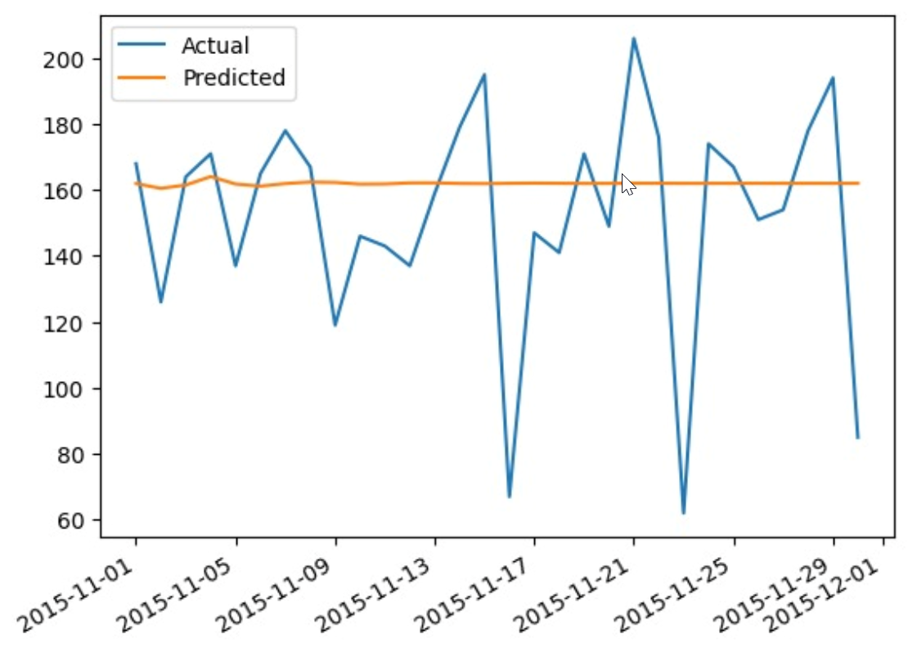
Model Deployment and Optimization

Slide 19

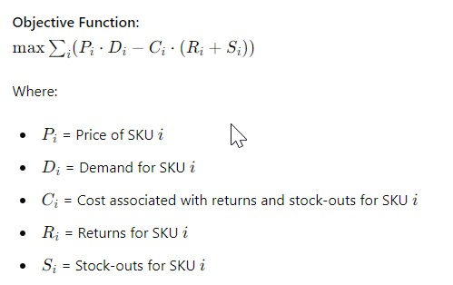
Optimization Problem
To maximize revenue and minimize returns and stock-outs, we can formulate an optimization problem as follows:
Maximize Revenue:
Objective: Increase sales by ensuring sufficient inventory to meet forecasted demand.
Constraints: Maintain optimal stock levels to avoid overstocking and understocking.

Slide 20
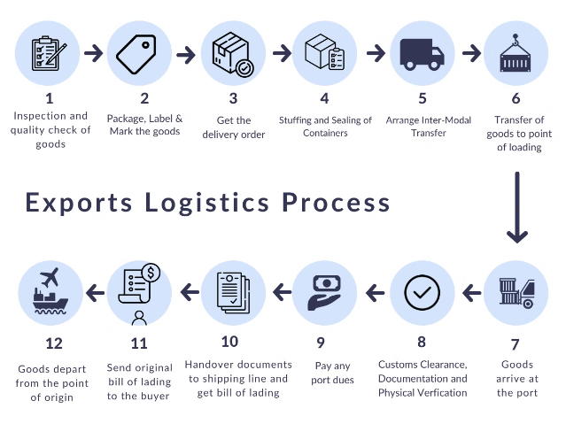
Optimization Problem
Minimize Returns and Stock-Outs:
Objective: Reduce losses due to product returns, primarily caused by expiry, and minimize stock-outs, which lead to lost sales.
Constraints: Implement effective inventory management strategies based on accurate demand forecasts. By solving this optimization problem using linear programming or other suitable techniques, iD Fresh Foods can optimize its supply chain, enhance customer satisfaction, and maximize its overall profitability.

Slide 21
Conclusion
This optimization can be solved using linear programming or other suitable optimization techniques.
By implementing these strategies and models, iD Fresh Foods can optimize their supply chain, reduce returns, and maximize revenue.

